Slide 1
Introduction to Programming
Dr Faisal Bashir

Slide 2
Agenda
Programming Languages
Programming Paradigms
Why C++
Brief History of C/C++
Problem Solving
  Flow Charts
  Pseudocode

Slide 3
Computer Programming
The functions of a computer system are controlled by computer programs
A computer program is a clear, step-by-step, finite set of instructions
A computer program must be clear so that only one meaning can be derived from it,
A computer program is written in a computer language called a programming language

Slide 4
Programming Languages
There are three categories of programming languages:
  1. Machine languages.
  2. Assembly languages.
  3. High-level languages.
    Machine languages and assembly languages are also called low-level languages

Slide 5
Programming Languages (cont’d)
A Machine language program consists of a sequence of zeros and ones.
  Each kind of CPU has its own machine language.
Advantages
  Fast and efficient
  Machine oriented
  No translation required
Disadvantages
  Not portable
  Not programmer friendly

Slide 6
Assembly Language
Assembly language programs use mnemonics to represent machine instructions
Each statement in assembly language corresponds to one statement in machine language.
Assembly language programs have the same advantages and disadvantages as machine language programs.
Compare the following machine language and assembly language programs:
8086 Machine language program for var1 = var1 + var2 ; | 8086 Assembly program for var1 = var1 + var2 ;
1010 0001 0000 0000 0000 0000 0000 0011 0000 0110 0000 0000 0000 0010 1010 0011 0000 0000 0000 0000 | MOV AX , var1 ADD AX , var2 MOV var1 , AX

Slide 7
High-Level Programming Languages
A high-level language (HLL) has two primary components
  (1) a set of built-in language primitives and grammatical rules
  (2) a translator
A HLL language program consists of English-like statements that are governed by a strict syntax.
Advantages
  Portable or machine independent
  Programmer-friendly
Disadvantages
  Not as efficient as low-level languages
  Need to be translated
Examples : C, C++, Java, FORTRAN, Visual Basic, and C#

Slide 8
Programming Paradigms
Why are there hundreds of programming languages in use today?
  Some programming languages are specifically designed for use in certain applications.
  Different programming languages follow different approaches to solving programming problems
A programming paradigm is an approach to solving programming problems.
A programming paradigm may consist of many programming languages.
Common programming paradigms:
  Imperative or Procedural Programming
  Object-Oriented Programming

Slide 9
Programming Paradigms: Imperative
In this paradigm, a program is a series of statements containing variables.
Program execution involves changing the memory contents of the computer continuously.
Example of imperative languages are: C, FORTRAN, Pascal, COBOL etc
Advantages
  low memory utilization
  relatively efficient
  the most common form of programming in use today.
Disadvantages
  difficulty of reasoning about programs
  difficulty of parallelization.
  Tend to be relatively low level.

Slide 10
Programming Paradigms: Object-Oriented
A program in this paradigm consists of objects which communicate with each other by sending messages
Example object oriented languages include: Java, C#, Smalltalk, etc
Advantages
  Conceptual simplicity
  Models computation better
  Increased productivity.
Disadvantages
  Can have a steep learning curve, initially

Slide 11
Which Programming Paradigm is Best?
Which of these paradigms is the best?
  The most accurate answer is that there is no best paradigm.
No single paradigm will fit all problems well.
Human beings use a combination of the models represented by these paradigms.
Languages with features from different paradigms are often too complex.
So, the search of the ultimate programming language continues!

Slide 13
Why C++

Slide 14
Why C++ ?
You can’t learn to program without a programming language
The purpose of a programming language is to allow you to express your ideas in code
C++ is the language that most directly allows you to express ideas from the largest number of application areas
C++ is the most widely used language in engineering areas
  http://www.research.att.com/~bs/applications.html

Slide 15
Why C++ ?
C++ is precisely and comprehensively defined by an ISO standard
  And that standard is almost universally accepted
C++ is available on almost all kinds of computers
Programming concepts that you learn using C++ can be used fairly directly in other languages
  Including C, Java, C#, and (less directly) Fortran
Stroustrup/Programming

Slide 16
History

Slide 17
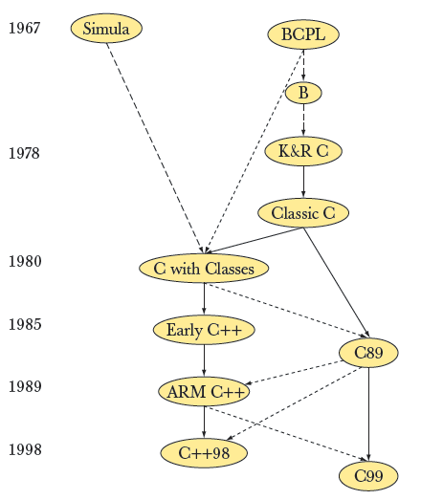
Modern C and C++ are siblings

Slide 18

C and C++
Both were “born” in the Computer Science Research Department of Bell Labs in Murray Hill, NJ

